Slide 1
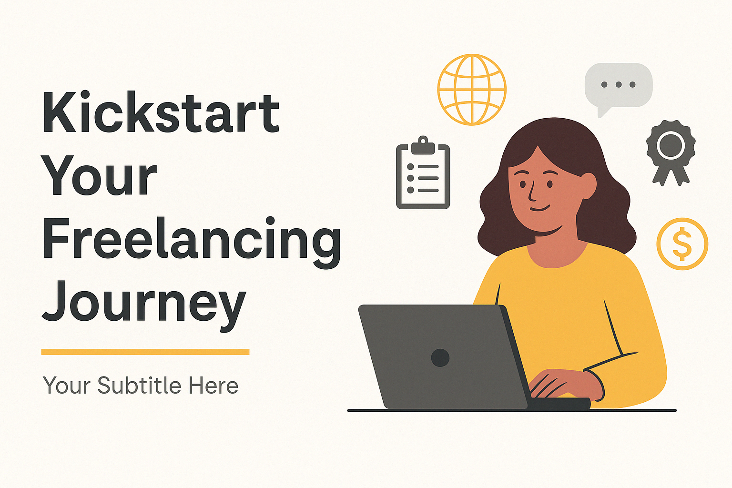
Kickstart Your Freelancing Journey
Learn. Earn. Grow.
Presented by: Memoona

Slide 2
What is Freelancing?
- Working independently for clients
- No long-term contract or fixed job
- Project-based work
- Flexible hours and location

Slide 3
Why Choose Freelancing?
- Work from home
- Be your own boss
- Choose your clients and projects
- Great for students, moms, and creatives

Slide 4
Popular Freelancing Platforms
| Platform | Description |
|----------|-------------|
| Fiverr | Gig-based services |
| Upwork | Project bidding platform |
| Freelancer.com | Bidding + contests |
| Toptal | Expert-level freelancing |
| PeoplePerHour | Hourly jobs and projects |

Slide 5
In-Demand Skills in 2025
Tech Skills: Web Dev, Python, Data Science,ML,NLP,LLMs etc
Creative Skills: Video Editing, Graphic Design, SEO
Other: Resume Writing, Virtual Assistance, Transcription

Slide 6
Creating a Winning Profile
- Use a professional photo
- Strong, clear bio
- Portfolio with 2–3 samples
- Niche-specific titles (e.g., "Landing Page Expert")

Slide 7
How to Get First Client Without Experience
- Create your own samples
- Start with low-priced gigs
- Join relevant Facebook/Discord groups
- Send personalized offers

Slide 8
Gig Lab – Activity Time
Task: Write your first gig idea!
- Title (e.g., I will write engaging blog posts)
- 3 bullet points on what it includes
- Use Canva to create 1 gig image (optional)

Slide 9
Pricing Strategy
- Start low to gain reviews
- Study competitor pricing
- Offer Basic / Standard / Premium packages

Slide 10
Bonus Tips
- Always be professional and polite
- Deliver before deadlines
- Build relationships with clients
- Keep upgrading your skills

Slide 11
Q&A + Resources
- Any questions?
- Useful YouTube channels
- Practice platforms for new freelancers

Slide 12
Thank You
Follow your passion. Learn. Earn. Grow.
Let your skills work for you!

